Slide 1
Agile: the basics
Digital Sprint - Ghent
17/05/2023

Slide 2
Welcome!
Let’s discover today the wonderful
Agile methodology!

Slide 3
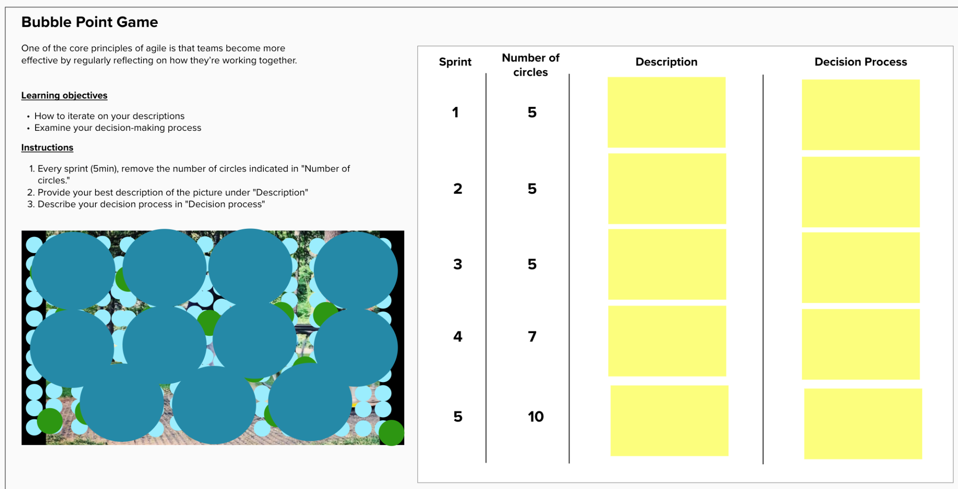
First let’s play a game
Notes:
Team 1: https://app.mural.co/invitation/mural/becode3468/1684216736064?sender=u3badbb0d4e9a17ab80537473&key=35258d8b-1b47-4496-9ef3-20308c6d19b3
Team 2: https://app.mural.co/invitation/mural/becode3468/1684216755700?sender=u3badbb0d4e9a17ab80537473&key=47a0b3c4-1bdd-4061-b313-41edc46ece8e
Team 3: https://app.mural.co/invitation/mural/becode3468/1684216865149?sender=u3badbb0d4e9a17ab80537473&key=39c13740-cba1-4428-9a24-928df1c7823b

Slide 4
Agile Basics

Slide 5
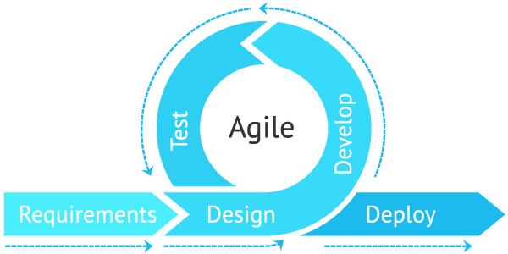
What is Agile ?
Methodology for project management & software development
Iterative approach (small increments)
Continuous evaluation

Slide 6














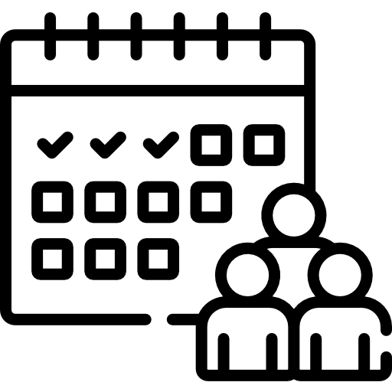

Principles & Practices
Which benefits ?
What can I expect ?
Time will be better managed
Increase business value
Customer satisfaction
Open to constant change
Delivering frequent value
Daily collaboration
Customer satisfaction > no fire / no resign
Adequate scope
Principles
Keep track on the progress
Motivated
team
Face-to-face
communication
Progress measurement
Sustainable work pace
Decrease frustration
Feedback > mutual help + alignment
Quick prototyping
Customer satisfaction
Good atmosphere / cohesion
Technical excellence
Simplicity
Self-organized
team
Continuous improvement
Efficient usage of the time
Better version management
Product Adoption
Valuable product
Coverage if someone is off / behind
Easier maintenance
The product arrives quicker
Practices
Reduce stress level
Iterative development
Daily meetings
Project Management
tools
Team
Product
Customer

Slide 7



The Agile Team : Roles
Product Owner
Scrum Master
Team Members
Product Vision
Planification
Link between customer and team
Keeper of Scrum Process
Facilitator
Delivery

Slide 8




Persona: description of a typical end-user
Picture & Name
Details
Goal
Gender: Male
Age: 68
Country: UK
Job title: Spy
Employer: British secret services
Income: very high
Would like to buy a new watch
The watch must :
Be innovative / original
Include new tech features
Include precious materials
Be waterproof
Be elegant (design is very important)
Affinities: guns, gadgets, cars, luxury, tech
Attitude: very smart, alpha male, loves women, athletic
James Bond
Notes:
User Persona is a detailed real or hypothetical description of a typical end-user of the product the team is developing. Personas usually take the form of a written document with a photo, name, profession, style of living, and other important details.

Slide 9
It’s your turn !
Imagine an innovative Tech project
Define the roles within your team (Product Owner, Scrum Master, Dev Team)
Define your target persona (at least two)

